Slide 1
Preparing for Exam Success

Slide 2
What we will be covering…
What to expect in the next 3 months
Key revision tips
How to be fully prepared (academically, mentally and physically)
How parents can support their child
Mobile devices – Friend or Foe

Slide 3
What to expect in the next 3 months

Slide 4
Summer Examinations 2022 the story so far…
Unless there is some sort of Public Crisis, Summer Examinations will be taking place this summer.
Dates for Exams – 16th May – 27th June (29th June Contingency Day)
Advanced Information released on 7th February
Distribution of grades will be somewhere between 2019 -2021

Slide 5
Subject Teachers
All subjects will provide specific guidance about:
What is required by the specification
Provide suitable revision resources
Look at Past Papers and Mark Schemes
Talk through effective revision and exam techniques
Provide a variety of additional revision resources via MS Teams

Slide 6
Student Preparations
Revise
Revisit
Recall
Rest

Slide 7
Key revision tips

Slide 8
Mr Wycherley

Slide 9
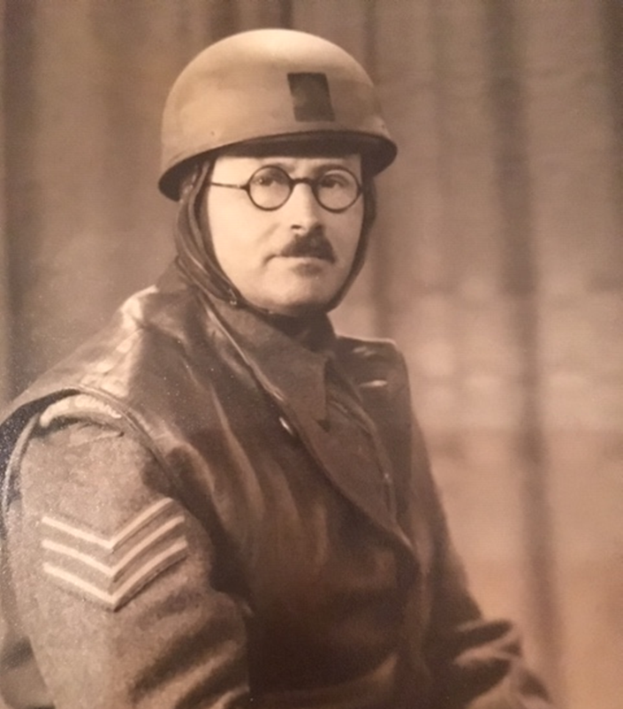

Slide 10
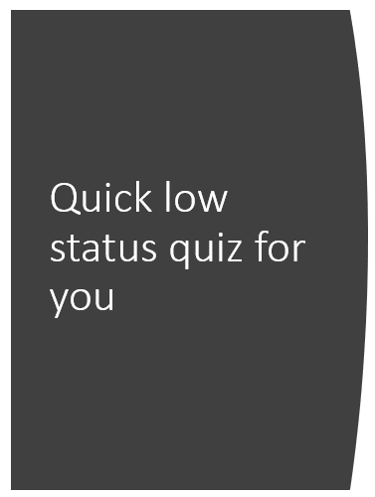
Notes:
I am going to ask you to look at the following sequence of letters for 30 secs and test you on them. Many will struggle to get past 7 or 8. here's another set of 15 letters, grouped in a similar order. How did you get on with those? Anyone remember all of them?

Slide 12
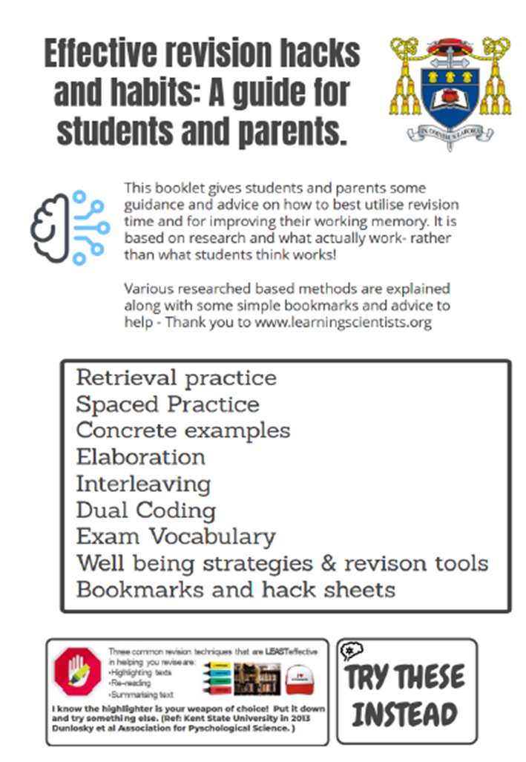
Ideas for parents
This booklet gives you plenty of ideas on how you can help you child with their recall, retrieval and therefore give them more ‘working memory space’
That's the bit that does the thinking- analysis, evaluation, hypothesis etc.

Slide 14
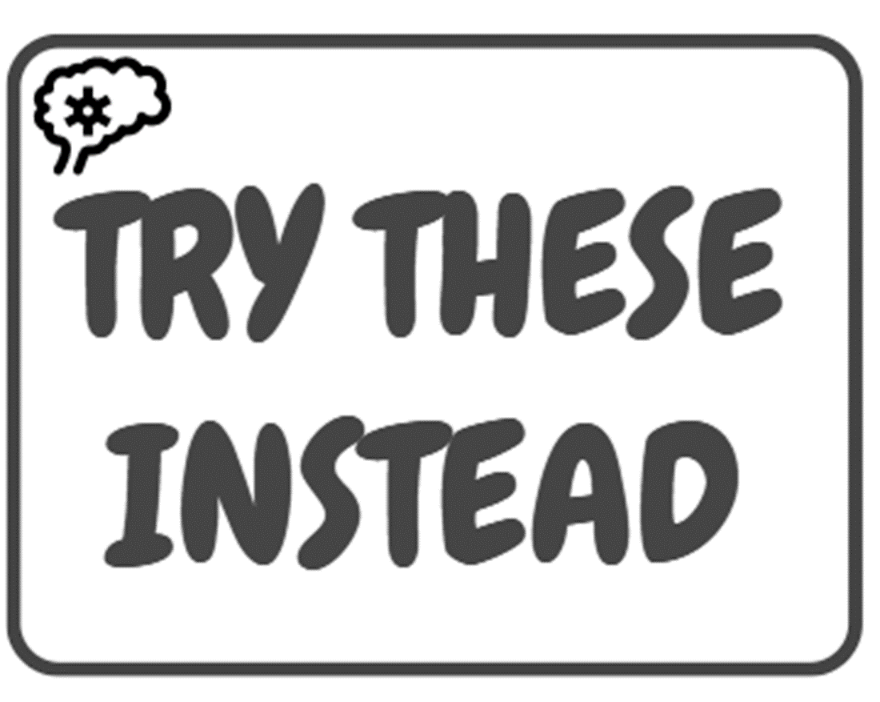

Slide 16
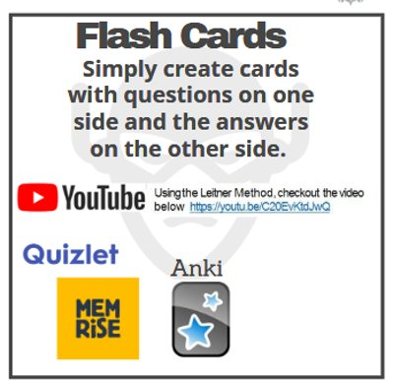

Slide 17
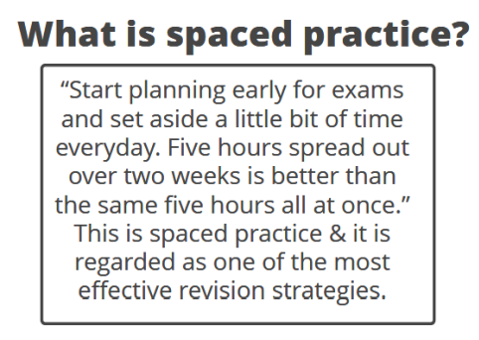
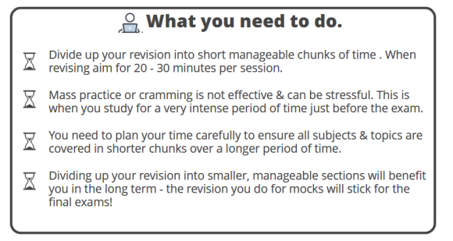

Slide 18
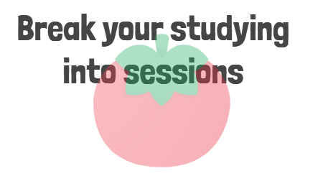

Slide 20
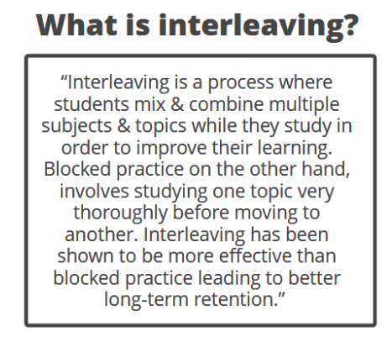

Slide 23
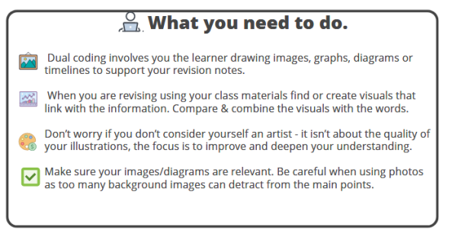

Slide 24
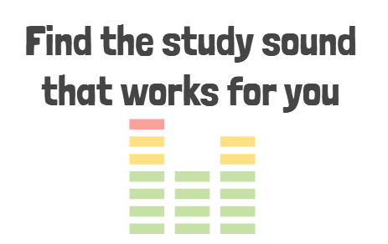

Slide 25
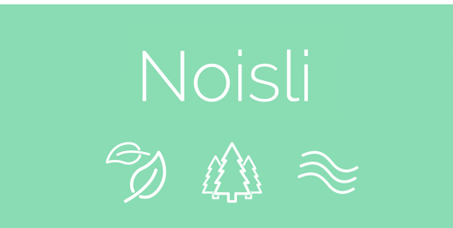

Slide 26
Planning is key

Slide 27
Getting ready to revise
Realise and accept that there are things in your life which will distract you from preparing properly for your A Levels…..
X box
TV
Phones
Social media
Hunger

Slide 28
1. Getting Started
Revision should have begun :
Recapping on prior learning should be an ongoing part of independent learning. Focus on learning and understanding before you start revising.
Entering FULL revision mode too soon can lead to burn out and forgotten information
You should however go over your notes regularly to refresh your knowledge and make links between topics
Most people shift their focus to exam revision about two months before their first exam (however this time can vary slightly)
Try to avid starting so late that you run out of time to revise everything properly.

Slide 29
2. Making a Plan
It’s important to make a plan that covers everything you have to revise:
Work out what content have to revise (you may want to go back to the advanced information to help you with this), this will help you to plan how much time you need!!
This will also allow you to break up your revision into manageable chunks so it seem less like a mountain to climb.
When sorting through the content decide how confident you feel about each topic, this will help you work out how much time is needed on each area.
Start thinking early on about what kind of revision might work best for you; exam practice, mind maps, flash cards etc…..

Slide 30
3. Revision Space
Having a good place to revise is just as important as having a good place to study, here are some tips on how to set yourself up for productive revision:
Make sure you are comfortable, think:
Tidy – make sure you are in a clutter free environment
Well-lit – makes things easy to read, and make sure you have everything you need nearby to avoid distraction
Proper seat - a space you are comfortable sitting in for a long period of time
Set the volume – ensure you are in a quiet space so you can concentrate. Some people like a little background noise. Listening to some instrumental based music can help you relax and stay focussed.

Slide 31
4. Gather notes and look for gaps
It’s a good idea to start your revision for a subject by compiling all the notes you have for each topic. Dedicate some time to sorting through and organising everything before you get into the thick of your revision – it will save you time later on.
Once you have organised your notes check them against the course specification to make sure they cover everything. The spec will show you all the material you could be tested on in the exam.
It might help you to print off the spec and tick off each point as you go.
Fill in any gaps by adding to your notes:
You can use a revision guide or a text book to help
Use the internet by looking at the exam board website and other reliable sources
You can always ask your teachers too.

Slide 32
5. Using Key Information
The process of simplifying your notes will make you actively engage with the content and help reinforce the key information. You’ll also be left with a version of your notes that you can use to quickly refresh your knowledge of a topic without needing to read through everything.
One of the simplest ways of condensing your notes is to try and write a shortened version of them on small pieces of paper or cue cards.
Your condensed notes will be a helpful revision aid in themselves, but it’s definitely a good idea to produce other revision aids too. These will all help you reinforce your knowledge in different ways.

Slide 33
Find ways to improve after you’ve done a paper
Mark Schemes:
These give you the correct answers and show you how marks are allocated. Checking your answers against the mark scheme will help you identify questions you struggled with and work out what you could have done better.
Mark schemes often want you to be very specific in your answer, eg to use certain terminology to get the mark. Looking through them will help you to identify what information you need to put in your answers.
They also show you how many marks are given for each assessment objective in a question, this can help you to work out how much to focus on each AO in certain question types.

Slide 34
Find ways to improve after you’ve done a paper
Examiners’ Report:
These reports are written by the people who mark the exams so they are full of useful advice, including what kind of answers were successful and what mistakes candidates often made.
Use the success and mistakes of past candidates to help guide your answers, including working out what to focus on and what to avoid doing.

Slide 35
Don’t worry if you’re struggling at first
Having a go at practice papers can be stressful, especially if you’re not doing as well as you’d like to, but try not to panic.
The more practice you do, the more familiar you’ll become with what to expect in the exam, this should increase your confidence and make things less frightening on the day.
You might want to try sitting some practice papers twice, if you struggled with a paper, try leaving a bit of time and then resitting it latter in the revision process. Hopefully, you’ll have made some encouraging progress. Hopefully, you’ll have made some encouraging progress, which should help you feel better about your revision.

Slide 36
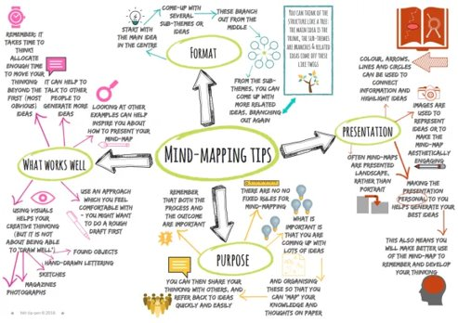
Mind Maps
The act of making a mind map can help visualise information and identify links between points.​
Mind maps can also help you to recall key pieces of information in an exam if you are able to picture a specific mind map and what’s written on it.

Slide 37
Working with others
While most of your time will be spent revising independently, varying your routine and working with others can help keep things fresh (as long as you don’t distract each other)​
You could:​
Teach each other – trying to explain a topic to someone else is a good way of test how well you know it yourself​
Discuss ideas – You could share exam tips and strategies or pick a past paper question and discuss how you might answer it​
Test each other – Testing each other with quickfire questions in pairs or groups can be good for reinforcing information

Slide 38
Memory techniques
Sometimes it can help to use memory techniques to learn information :​
Mnemonics​ - The first letters of the words you need to know become the first letters of a sentence, song or rhyme​ Especially useful for learning information in a certain order​
Memory Journeys​ - Can be a way of linking landmarks on a journey with facts or words in a sequence​ For example if you go on a certain journey regularly you can link certain landmarks with a stage in a cycle or model

Slide 39
Creating a revision Timetable
Write down the dates of your exams​
Break each subject down into topic areas​
Then start to work backwards filling in when you are planning to have completed your revision for each area​
A good rule is to take a 10-15 minute break every hour!!​
Questions to ask yourself:​
What time of day do you work best?​
When do you get up, and go to bed?​
How long will you revise for each day?​
Fit in sensible breaks in your revision

Slide 41
How to be fully prepared

Slide 42
Remember that things don’t always go to plan
Try not to worry if you don’t keep to your revision schedule or don’t feel like you’re making as much progress as you would like, it’s important to accept that you’re not going to be productive 100% of the time.​
Try to avoid setting yourself unrealistic targets for the same reason, working in small, manageable chunks and taking regular breaks will help you keep motivated and stay positive.

Slide 43
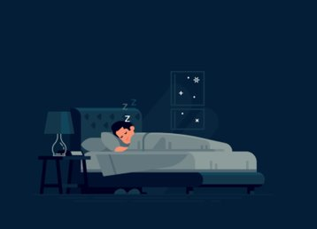
Some top ways of taking care of yourself​
1. Try to maintain a regular sleep pattern:​
Try to get enough sleep, especially if you’ve been revising for most of the day, sleeping helps you remember what you’ve learnt.​
Going to bed around the same time and setting an alarm for the next morning will help you create a consistent sleep routine.​
Try to do something relaxing before going to bed, but it’s best to avoid looking at a screen.​
Don’t be tempted to skip sleep to revise, you might struggle to concentrate on what you’re revising and you’ll feel tired the next day.

Slide 44
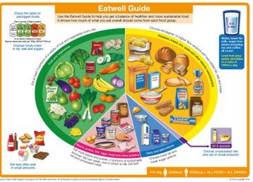
Some top ways of taking care of yourself​
2. Eat a balanced det and drink plenty of water:​
Try to eat a balanced diet (that means not leaving your veggies) and avoid skipping meals. This will give you energy and help you stay healthy.​
Make sure you drink water regularly to keep yourself hydrated.

Slide 45
Some top ways of taking care of yourself​
3. Keep active and get some fresh air:​
Going outside or exercising can be a really good way of clearing your head.​
This could be as simple as going for a short walk in your revision breaks

Slide 46
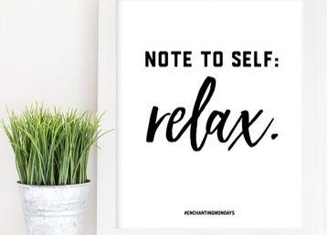
Some top ways of taking care of yourself​
4. Set time aside for relaxation and hobbies:​
Taking some time to relax and doing something you enjoy, either on your own or with friends, can give you a much needed break and stop you feeling overwhelmed by your work.​
Keep up some of your hobbies during revision period. As with most things, it’s important to find a balance.

Slide 47
Exams are important, but your health should come first…
5. Looking after your health is really important if you want to do well in your exams. If you’re feeling well rested and healthy, you’ll revise more productively, so don’t think that giving yourself a well earned brake is wasted time.

Slide 48
What can parents do?

Slide 49
Think… before, during and after
Get things together the night before…​
Help your child focus the night before, this could be practical preparations instead of last-minute revision:​
Help to Pack their bag with anything they need to take into the exam – don’t forget spare pens!!​ maybe throw in some small confidence boosting questions.
Make sure they know where and when the exam is​
Try to do something that takes their mind off the exam eg, exercising or relaxing together​
Help them with their final read over notes if it’s helpful, but don’t try to learn anything new.​
Ensure they eat a balanced meal and encourage a good night’s sleep.

Slide 50
On the day of each each exam
Make a routine for Exam Days:​
Setting an alarm so that they wake up with plenty of time to spare.​
Eating a healthy breakfast. Don’t worry too much if they don’t manage a big breakfast because of nerves, they can still do well in the exam.​
Choosing something comfortable to wear (that still follows the Sixth Form Dress Code)​
Helping them to look over notes for key bits of information (e.g. definition and formulas…) if they find it helpful, but don’t do too much.​
Making sure they leave home with plenty of time to get to the exam, especially if they need to use public transport. Try not to get there too early though, especially if a longer wait might make them feel more nervous.

Slide 51
Get them to be familiar with how they will feel
Practice how to stay calm when they arrive:​
Avoid talking to someone about the exam while they wait. It might help to chat about something else or to move away from others if they need some space to mentally prepare themselves.​
Try to make sure they don’t worry about the topics they wish they’d spent more time on, focus on the information they do know.​
Practice some techniques to help stay calm If they find themselves panicking, try to focus on breathing. Taking some deep breaths can help to calm them down and distract them from nerves before going into the exam

Slide 52
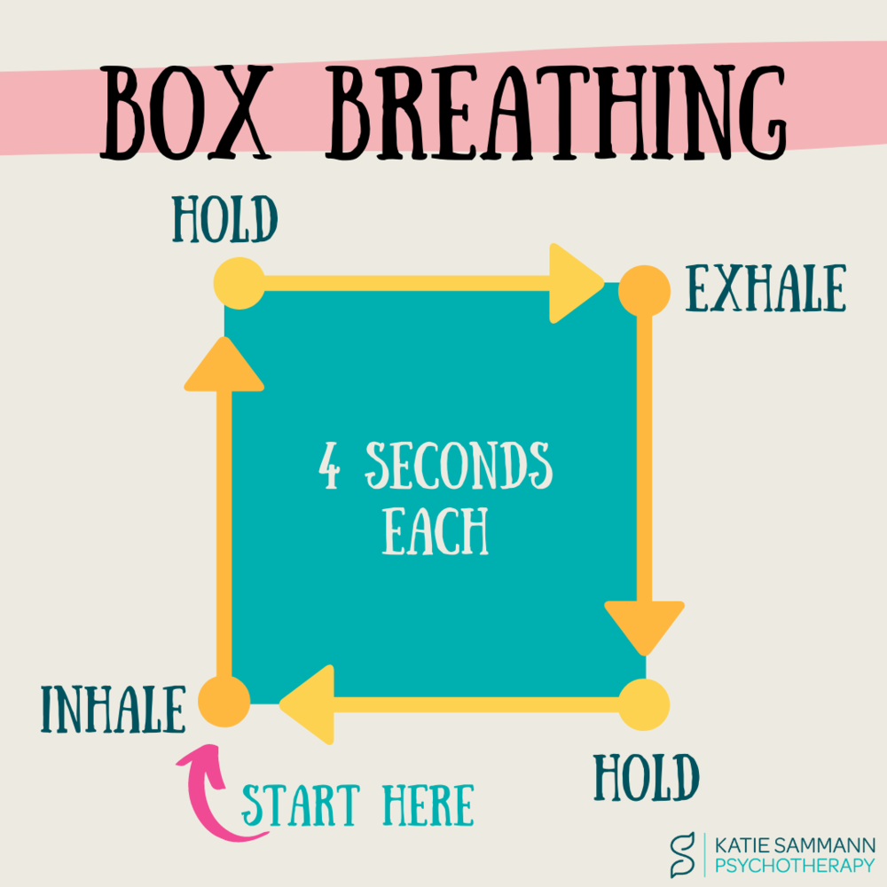

Slide 53
Practice, Practice, Practice
It’s important to stay focused during the exam and to make the most of the time they have, when practicing past papers at home try to recreate the process, going through the points below will normalise the routine:​
When you sit down, lay out your stationary to hep you get into the right mindset. Then once you’re allowed, read through the instructions carefully.​
To help you understand difficult questions, you could highlight command words or key concepts in the question wording.​
Keep an eye on the clock to help you manage your time, this will mean you’re more likely to have time to answer everything and check your work.​
Look at how many marks a question is worth when deciding how long to spend on it, try to avoid spending too much time on a question that aren’t worth many marks.​
Put a quick plan together for any longer answers, e.g. essays​
If you find yourself stuck DON’T WORRY!!:​
Take some deep breaths and take a few sips of water, this can help you refocus.​
If you’re stuck on a question, move on to the next question and come back to it later.​
Concentrate on what you can do rather than what you can’t. Don’t get distracted by other people who seem to be ahead.

Slide 54
Exam debrief
Worry about the exam after will not help!:​
Worrying won’t change anything, so don’t spend too much time thinking or talking about the exam once it’s over.​
It can be helpful to think about whether there’s anything they could do better next time though:​
If they ran out of time, how they might use their time more effectively in the next exam?
If they felt tired, look at whether you could improve their routine the night before.​
If they panicked, try practicing some relaxation techniques they can use to stay calm in the future

Slide 55
Reflection
Try to help them relax after the Exam:​
Recharge by doing something they enjoy or find relaxing, this could be something as simple a going for a walk or watching a film.​
If they have another exam the same day or the next day, make sure that they still take a break before they start their final exam preparations.​
When they have completed an exam encourage them to put their revision notes for the exam they’ve just done away, this can act as a physical reminder of what they’ve achieved already!

Slide 56
Celebration time!!!
Once they’ve finished all of their exams, encourage them to put notes and revision materials out of sight (but don’t throw them away) give them break from thinking about exams.​
Plan a treat to celebrate all the hard work they’ve done over the past couple of years.

Slide 57
Phones – Friend or FOE

Slide 58
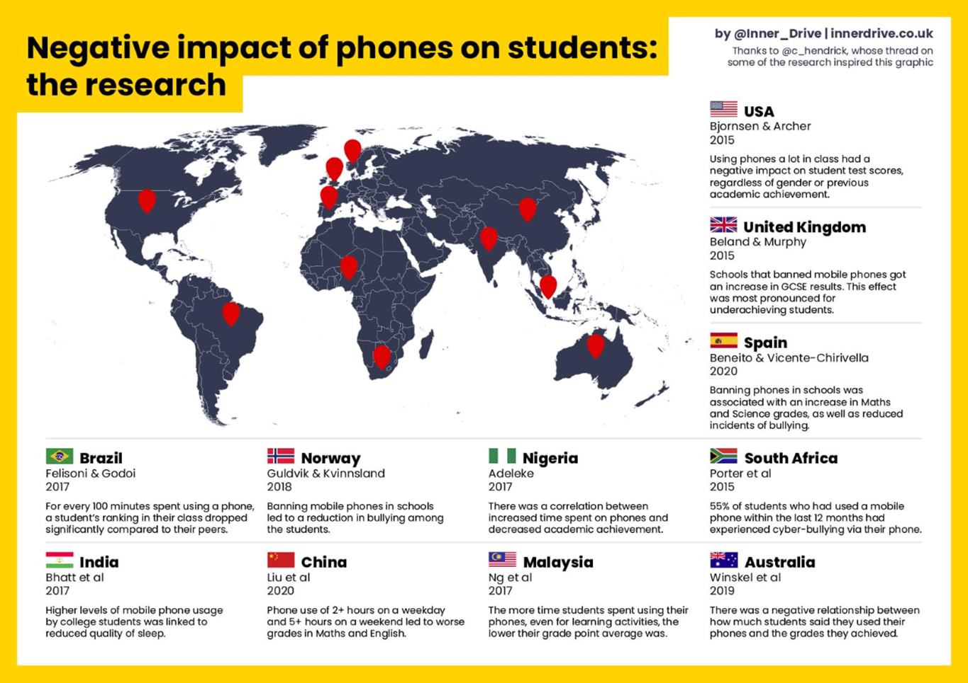

Slide 59
Exam Countdown Lite
This app provides a handy visual reminder of all your important upcoming dates. You can easily check how much time you’ve got before each exam. You can colour code all your exams, add notes / reminders and use icons as a quick visual reference for each subject.

Slide 60
My Study Life
This calendar app lets you build your own timetable to easily keep track of your classes, assignments and exams. It lets you assign tasks to specific classes and comes with reminders so you don’t forget a thing!
Plus, it comes with day and week rotation timetables, so you can easily personalise your alerts and reminders.

Slide 61
Evernote
It’s the ultimate organisation app that lets you add to-do lists, images, webpages, memos and more! You can type up notes, handwrite notes and photograph them, store things as word docs or PDFs - it really is the only organiser you’ll ever need!

Slide 62
SimpleMind
Mind mapping is a great study method as it helps organise your thoughts, spark your memory and come up with new ideas. With this APP you can create your own mind maps, or you can opt for one of the auto layouts and fill it in. Visually display critical concepts & information.

Slide 63
Headspace: Meditation & Mindfulness
Getting too stressed? Taking time to relax is just as important as putting in the hours! Meditation can be a great way to unwind as it relaxes and encourages focus which will also help you when you get back to your studies. Headspace has loads of different courses that are designed to help you with different aspects of your life – ie a Sleep course and a Productivity course.

Slide 64
AnkiApp
AnkiApp is a flashcard app that tracks your progress with a unique algorithm. Make flashcards with text, sound, and images, or download pre-made ones. Automatically does backups and sync to all your devices, via the cloud.

Slide 65
Study Music 🎧🎧 Memory Booster
Want to focus better? Listening to music can help clear your mind and get things done. With Study Music, you can choose different music for different tasks like studying, reading and being creative. Plus, you can add in nature sounds or alpha waves to make it easier to relax and improve your focus

Slide 66
Trello
Trello is a project management tool that you can use when you’re revising. You can create a new board for each topic that could come up in your exams, then make a card for each possible essay question. It’s a simple way of building up a bank of essay plans.

Slide 67
Forest: Stay Focused
YouTube binging is a real problem, one innocent film trailer can quickly turn into a four-hour marathon. Open the app whenever you sit down to revise and you’ll plant a tree, open your phone again while you’re meant to be revising… the tree dies. Don’t kill the trees. Stay focused!!

Slide 68
Quizlet
This is a great free download which allows you to make flashcards. You can use Quizlet in a few different ways, for example you can race against the clock in a game of match, test your memory with write mode or just use the classic learn mode. Use pre-made cards or make your own.

Slide 69
Todait
Productivity is key when you’re revising. Todait is a brilliant app designed to assist you in splitting everything you need to study over a specific time period. The app will even make changes to your schedule for you based on your progress!

Slide 70
Sleep Cycle
A good sleeping pattern is key to getting good grades. Lack of sleep can turn the most civilised person into a creature. Sleep Cycle is a clever little app which will keep an eye on your sleeping habits so you can be in prime condition for a productive revision session.

Slide 71
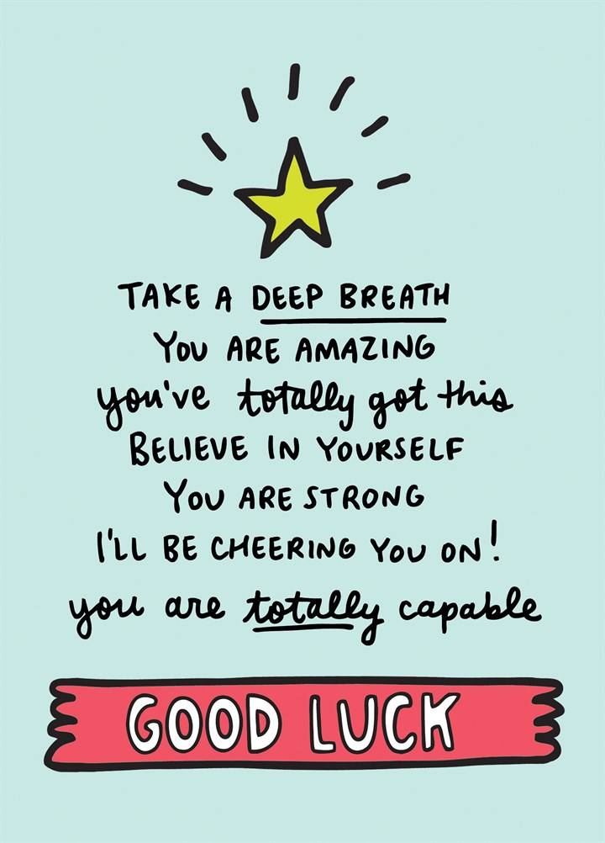
Thank you

