Slide 1
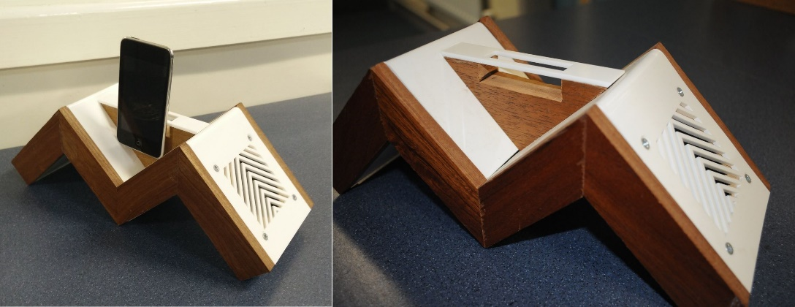
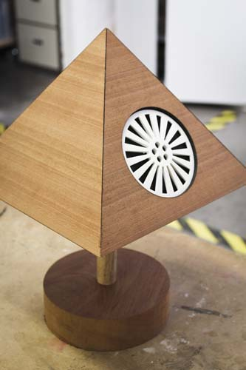
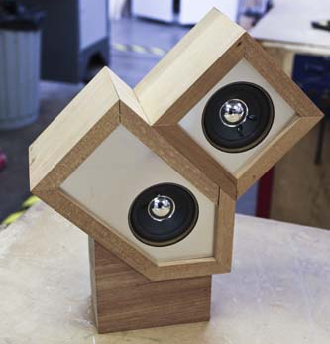
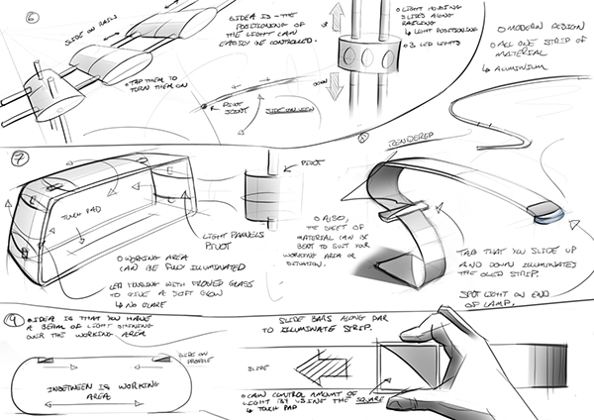
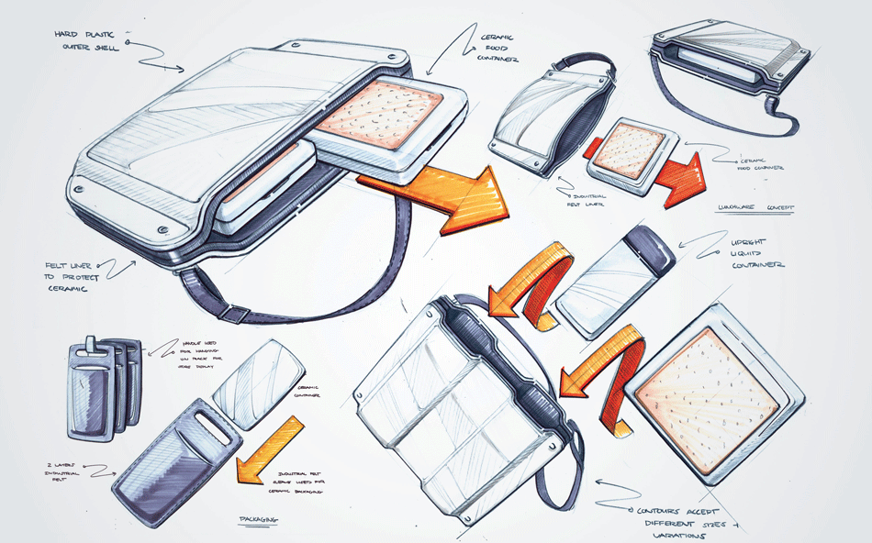
Product Design
AQA Product Design
Science
Computer Science
Product design and Engineering
Art
Maths
https://www.youtube.com/watch?v=tLY0uJEy38M

Slide 2
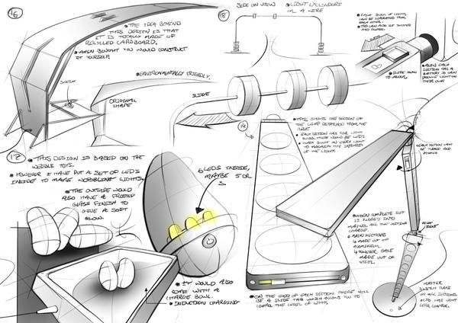
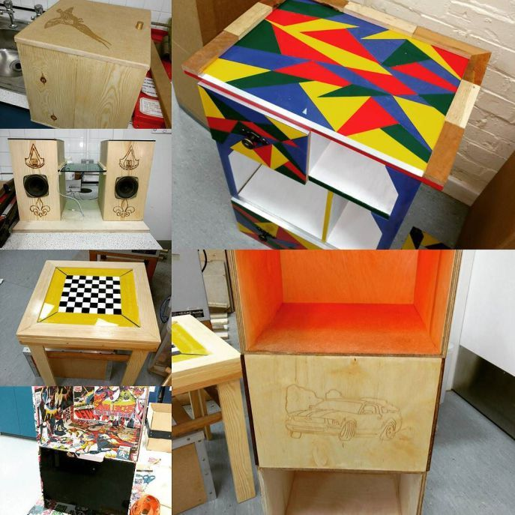
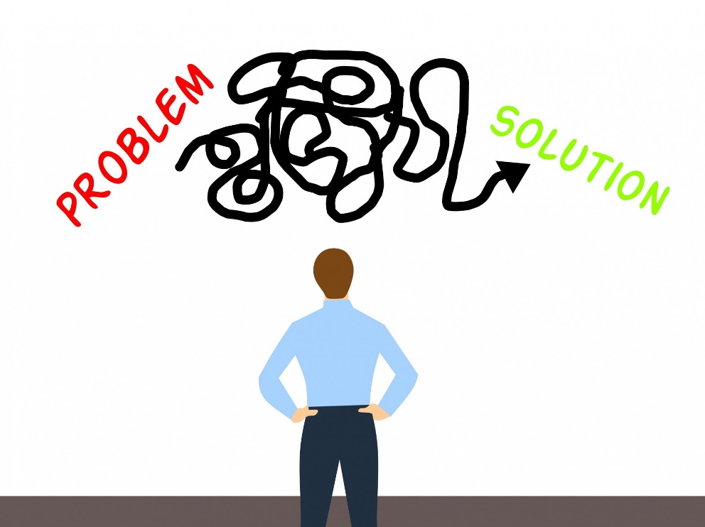
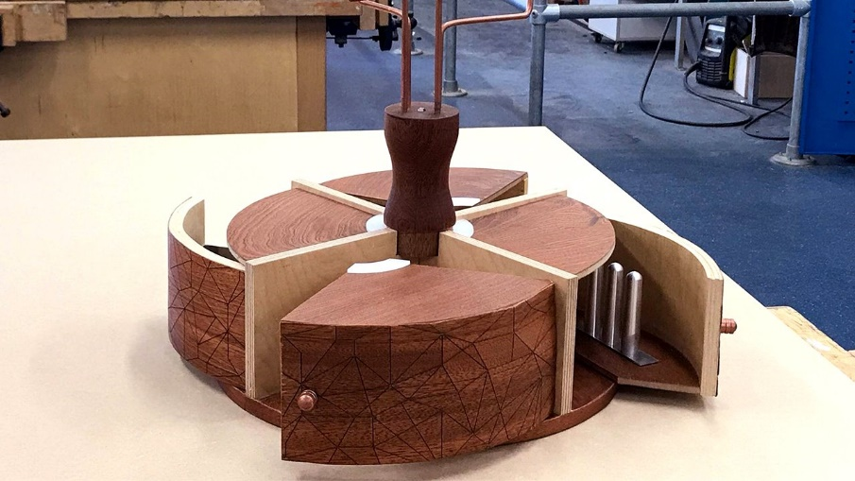
Product Design is all about solving a problem.
Product Design

Slide 3
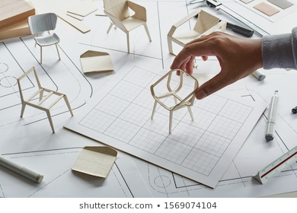
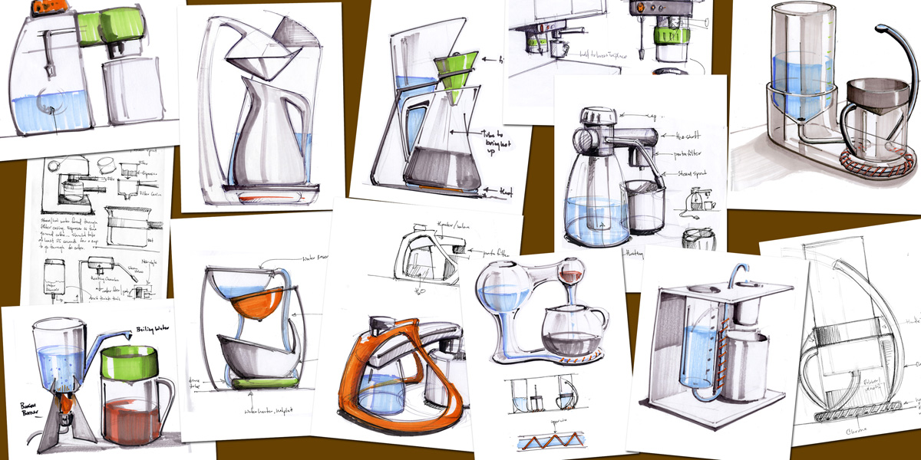
Product Design
What does the exam look like?
Exam: Worth 50% of your total grade. The exam looks at Designing, Manufacturing and Technological principals. We focus on this within year 10 and you do a number of practical lessons to underpin this theory (2 a fortnight)
NEA: Worth 50% of the total grade. Each year the exam board releases a problem that you need to solve:
2019 “Sustainable product”
2018 “Product suitable for a teenager”
Here you need to research, design and make a product which meets this brief.

Slide 4
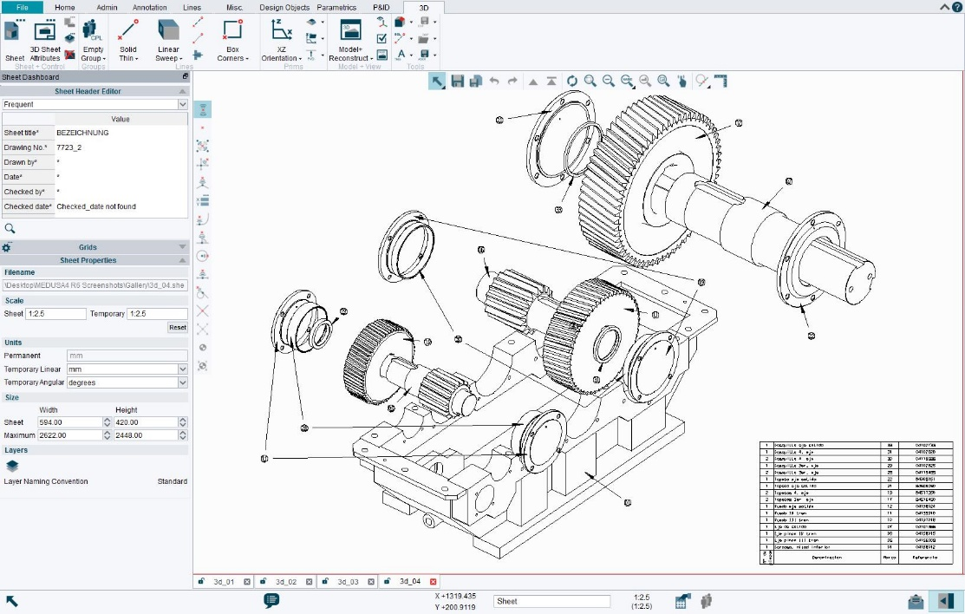
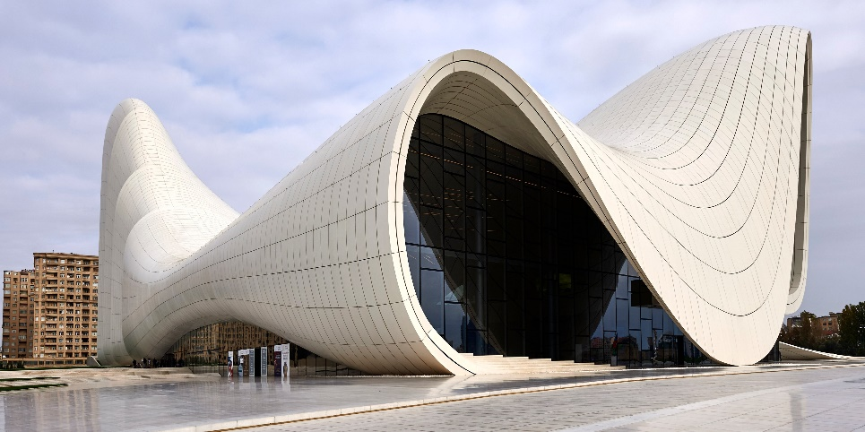
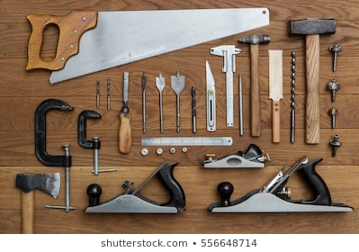
Product Design
What skills will I develop?
Problem solving
Designing / Drawing skills
Creativity
Applying theoretical knowledge
Evaluation and Analytical skills
Debate ethical questions

Slide 5
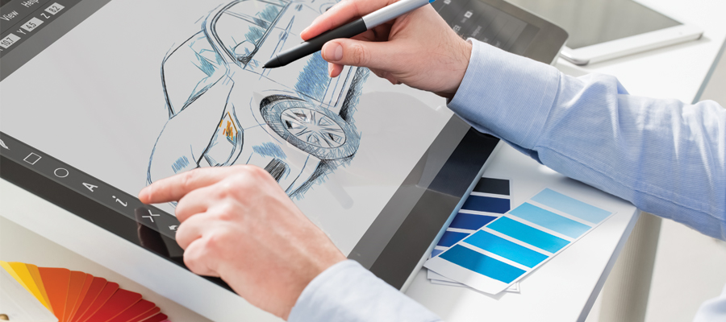
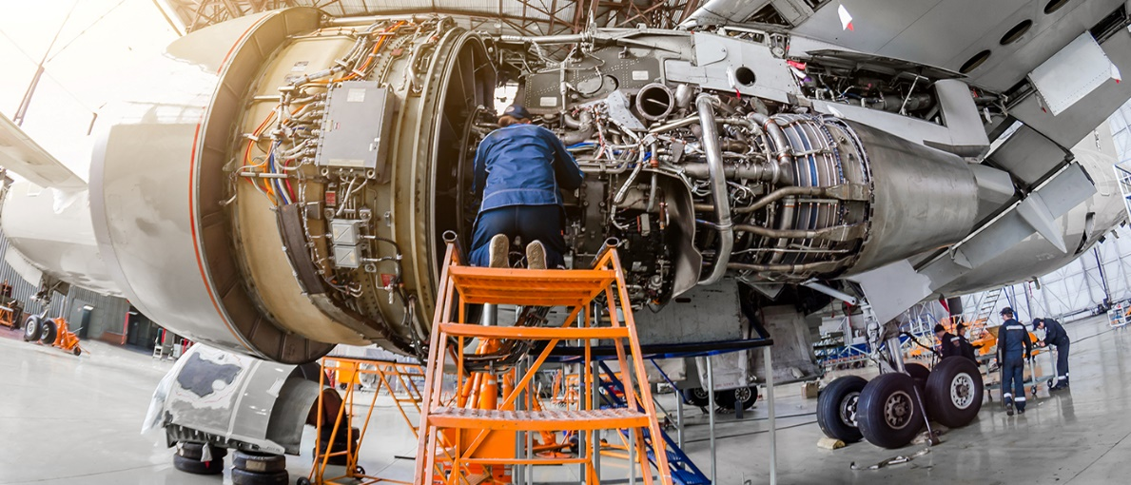
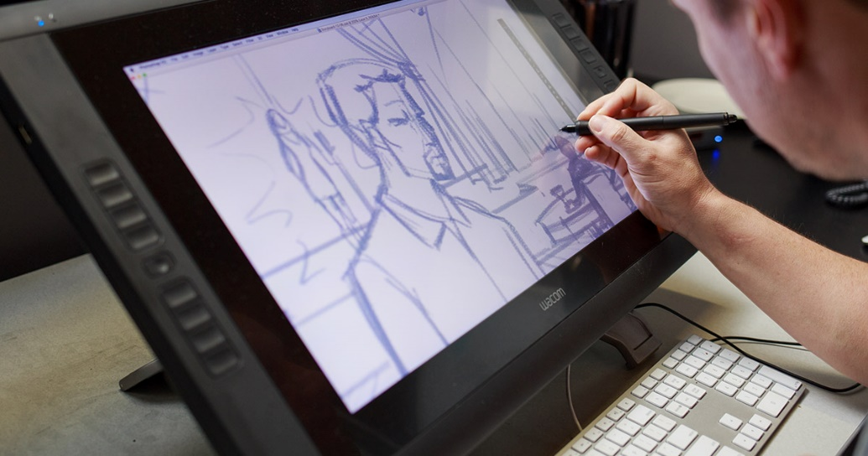
What careers does this course lead to?

