Slide 1
Creative iMedia
Cambridge Nationals Level 1 & 2

Slide 2
Creative iMedia
Digital Media is a key part of many areas of our everyday lives.
Production of digital media products is a requirement of almost every business.
This qualification will help students develop specific and transferable skills.
This qualification has a hands-on, practical approach.

Slide 3
Structure of the course
4 units of work:
Year 1 Pre-production skills
examined – 25%
Creating digital graphics
coursework – 25 %
Year 2
Creating a multipage website
coursework – 25%
Creating a digital sound sequence
coursework – 25%

Slide 4
Pre production skills
Underpins the other learning in this qualification.
Students learn how to understand client requirements and project briefs.
Students use this knowledge when they develop their own media products.
Develops transferable skills such as project planning.

Slide 5
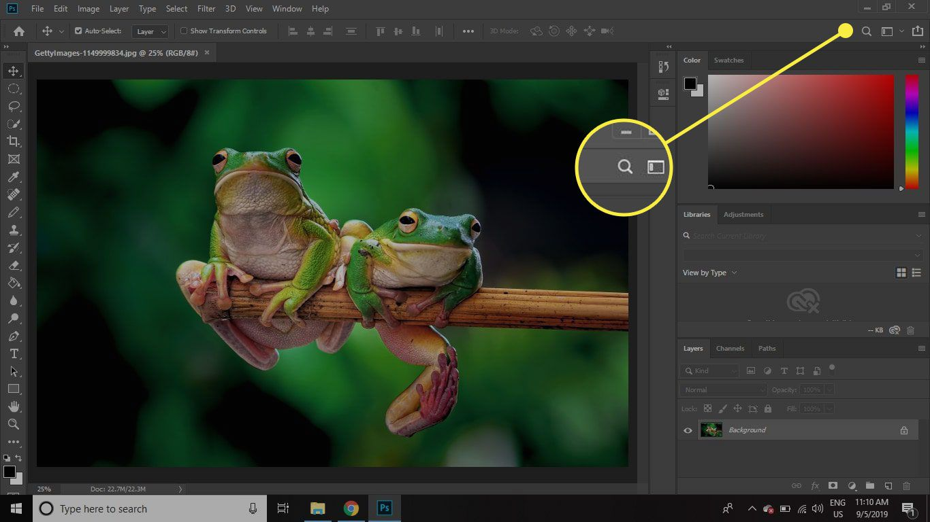
Creating digital graphics
Graphics are a key part of most products.
The work completed in this unit supports the other units completed.
Students will learn the basics of digital graphics editing.
Skills will be developed in the use of Adobe Photoshop.

Slide 6
Creating a multipage website
This unit enables students to understand the basics of creating multipage websites.
Students will use their creativity to combine components to create a pleasing website.
Skills will be developed in the use of Adobe Dreamweaver.

Slide 7
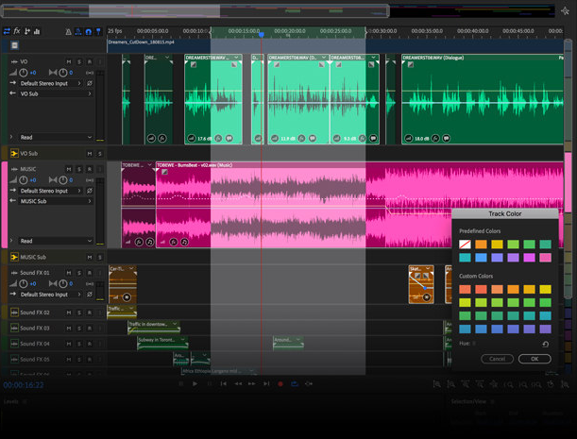
Creating a digital sound sequence
Digital audio is used to enhance and inform digital content.
Students will explore uses of audio products.
They will plan and produce a digital sound sequence.
Skills will be developed in the use of Adobe Audition.

Slide 8
Progression
Cambridge Nationals provide a strong base for progression to Further Education:
A Levels
Level 3 Technical qualification
Apprenticeships.

Slide 9
What is a Cambridge National?
Vocational qualifications for students aged 14–16.
They are just as challenging as a GCSE and are used in the same way as GCSEs to determine progress 8 and attainment 8 scores.
The qualifications are recognised by all 16–19 providers for progression to further study or work.
The qualifications are graded as Distinction*, Distinction, Merit and Pass and are equivalent grades to GCSEs at grade 9 to 1.

Slide 10
Questions
Mr Hanson – Subject Leader of Computing & IT
i.hanson@st-nicholas.cheshire.sch.uk

